Slide 1




[CHAPTER]
[TOPIC]
AIAA Caltech Student Branch – 18/11/20
Preliminary Design Review – H.O.M.E.S.
Header 1
Header 2
Header 3
Body
Note

Slide 2
VERIFICATION
TEST PROGRAM
AIAA Caltech Student Branch – 11/18/20
Preliminary Design Review – EASE
Goal: Validate to TRL4
Implement safety factor of 1.2 – 1.5
Key:
^ Under vacuum conditions
* Under thermal conditions
! Destructive test
† Full prototype needed
Vibration Test for Deployment †
EMI Test for EDS System^*†
Abrasion Test*!
Electronic Life Test for 45 years^*
Miscellaneous
Maximum Load Test*!
Simulated Abrasion Test*
Operational Test^*†
Mechanical Load Tests
600 N Pulsating Fatigue Test*!
Dust Exposure Test
Sharp Impact Test Simulating Micrometeorites*!

Slide 3
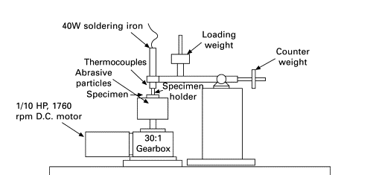
VERIFICATION
TEST PROGRAM
AIAA Caltech Student Branch – 11/18/20
Preliminary Design Review – EASE
Equipment and Testing Conditions
Currently looking for resources for vacuum and cryochamber
Lunar Simulant JSC-1A will be used for EDS-related testing
Lunar Simulants OB-1 and Chenobi are the most recommended simulants for abrasion and dust exposure testing
We will test from -260˚C to 140˚C to simulate lunar thermal conditions
Three-Body Abrasive Wear Test Rig
(Roy, 2008)

